Slide 1
Returning to
Face to Face Programming for NC 4-H
Training for agents and volunteers
Notes:
There is also a youth-friendly training: https://docs.google.com/presentation/d/1sCYtCNvjBBKznhexxMLDPYuZrMi2laYwaGpwkGAVg1U/edit?usp=sharing
Opening question: How does our approach to programming align to our values?

Slide 2
Guiding Questions
What influences the return to face to face programming?
What are the social implications?
What will we need to do?
What is the end goal?
Notes:
Returning to face to face programming will require us to implement new routines and shoulder new responsibilities. We can turn to the 4-H Pledge to help us place the face to face programming guidelines in the context of traditional 4-H values.
This guidance is based on the NC State University Extension Reopening Guidelines and is designed to align with Governor Roy Cooper’s Re-opening Guidelines. Because local ordinances and
circumstances may differ, all face-to-face 4-H programming must be approved by the County Extension Director. Any 4-H activity may necessitate the use of the following by Extension employees, volunteer leaders, 4-H youth, and others associated with the activity:
Þ Personal protective equipment (PPE) or cloth face masks
Þ Practicing social distancing
Þ Collecting names of participants
Þ Exclusion from the activity due to recent or current health status.

Slide 3
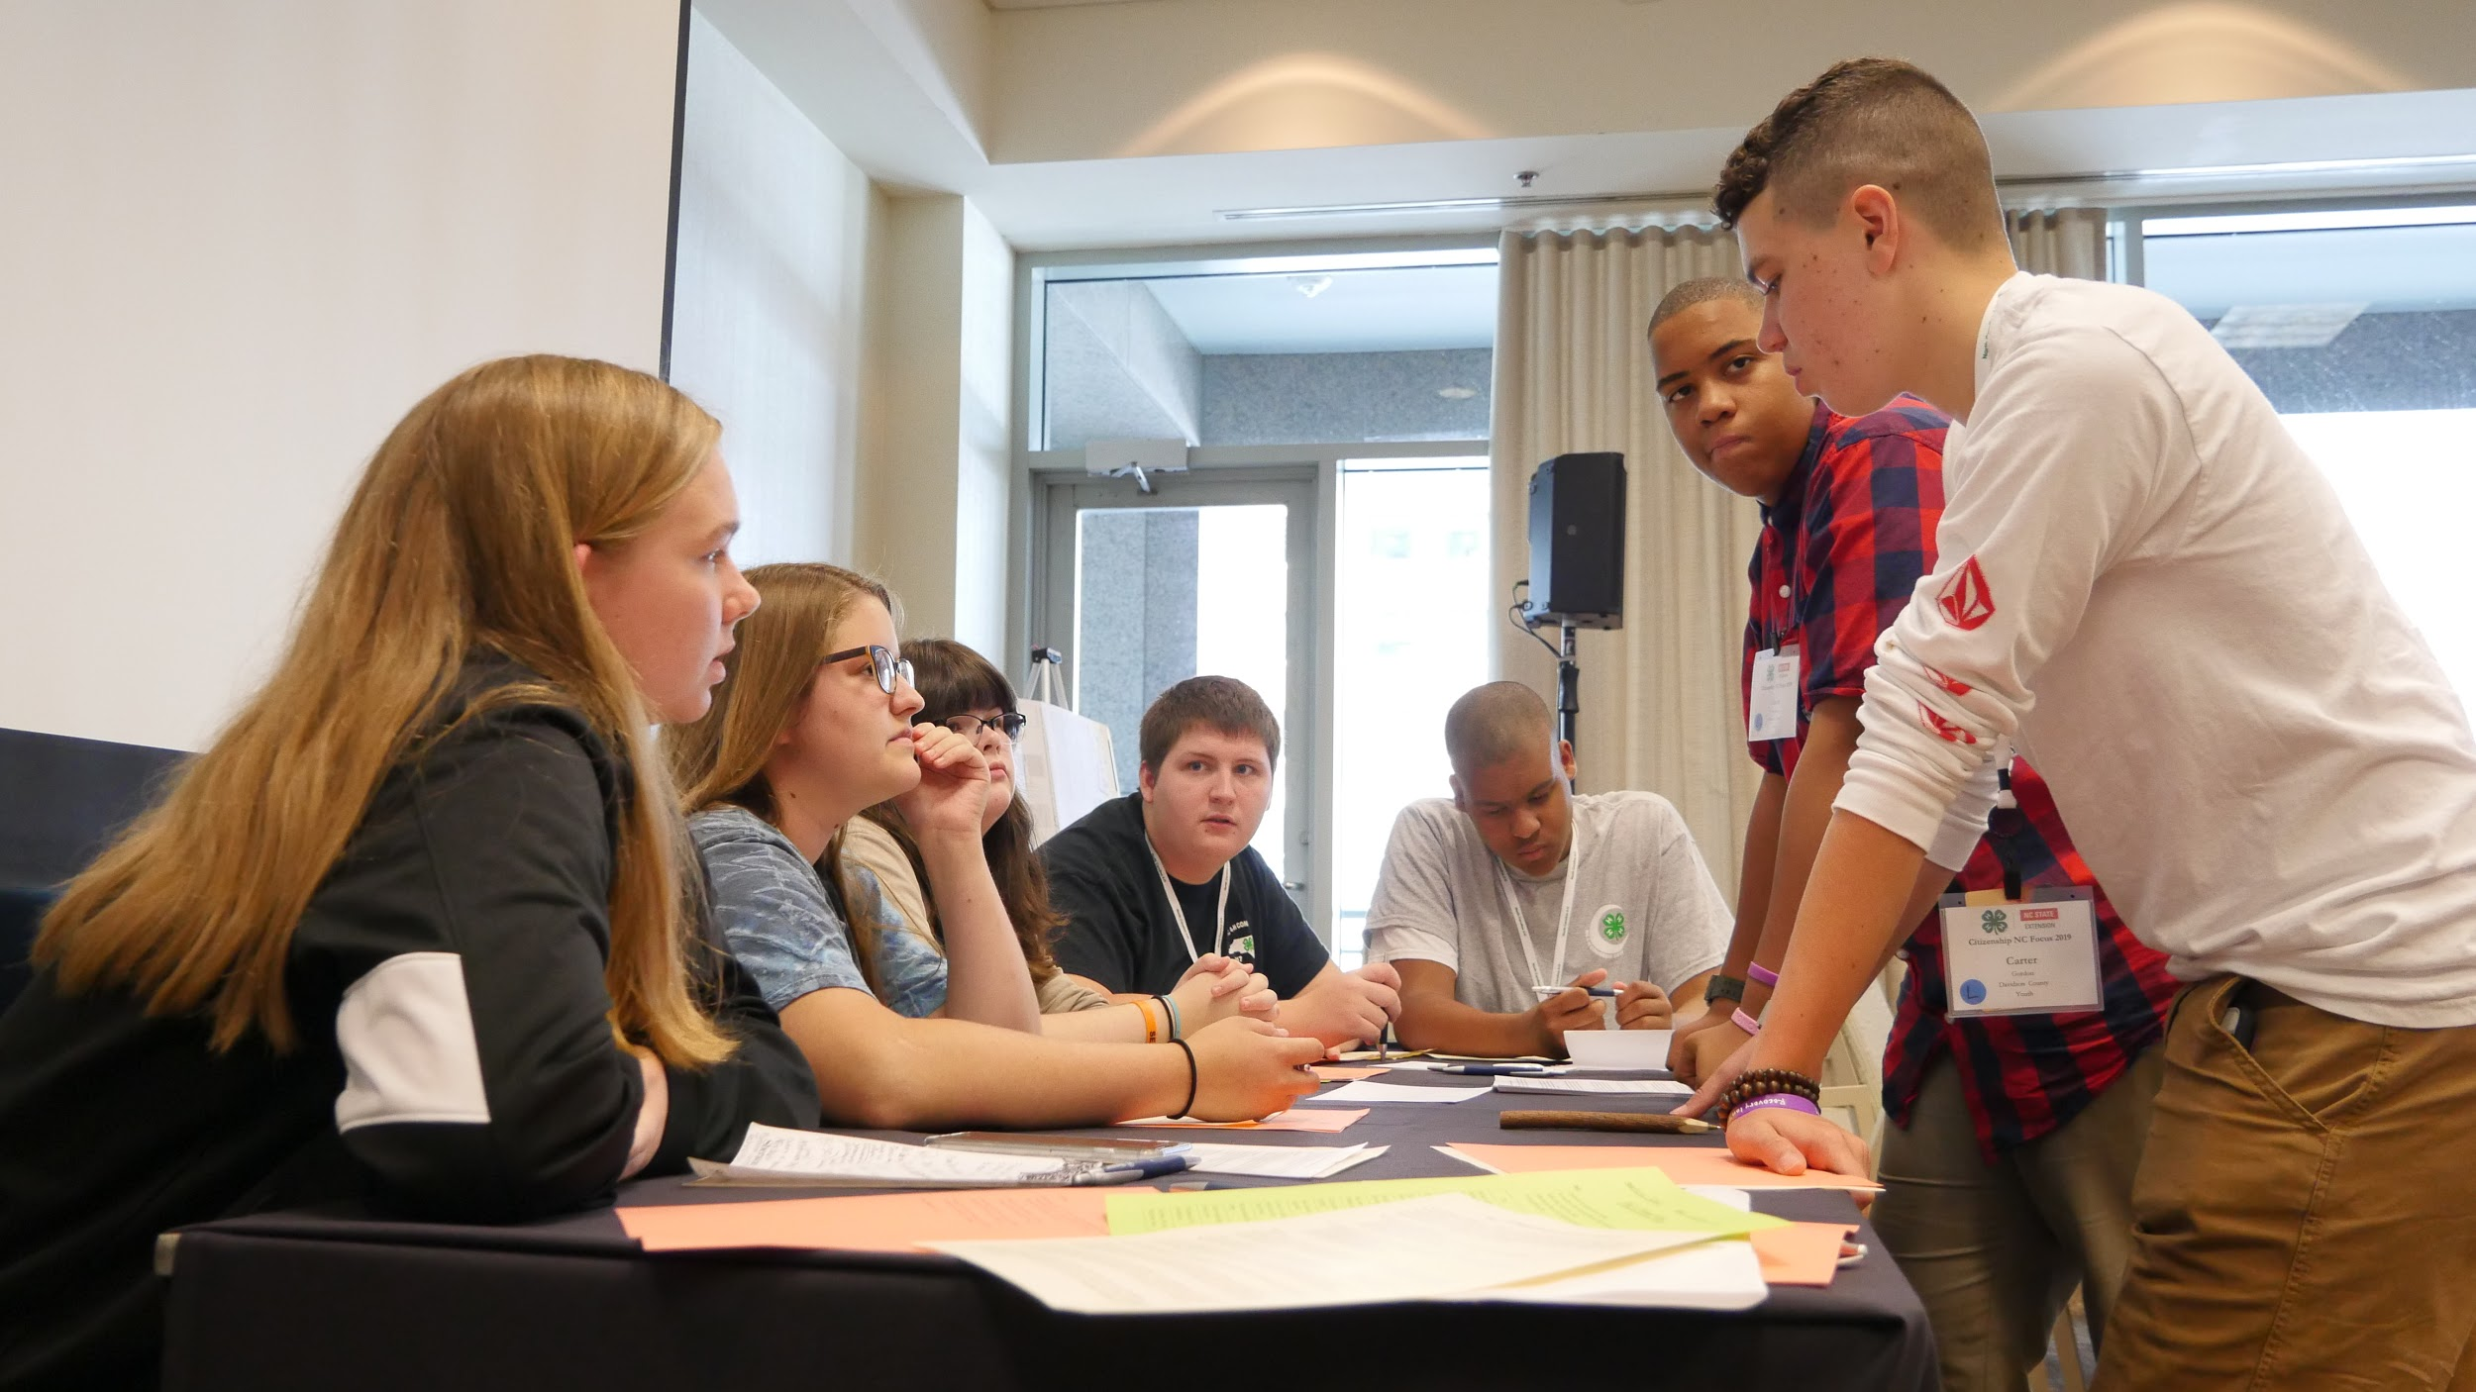
I pledge
My head to clearer thinking...
What influences the decision to return to face to face programming?
Notes:
Ask participants to briefly share their ideas.

Slide 4
North Carolina State University’s Re-Opening Guidelines
North Carolina’s Re-Opening Guidelines
Your County’s Re-Opening Guidelines
Your program
Notes:
Programming decisions are impacted by state, university, and local guidelines. These guidelines are frequently revised based on the most recent understanding of COVID-19, so staying in communication with your local health department is essential.
NCDHHS COVID-19 dashboard: https://covid19.ncdhhs.gov/dashboard
In all cases, the most restrictive guidelines must be followed. Be prepared to shut back down if guidance documents change due to COVID-19 spikes or other information.

Slide 5
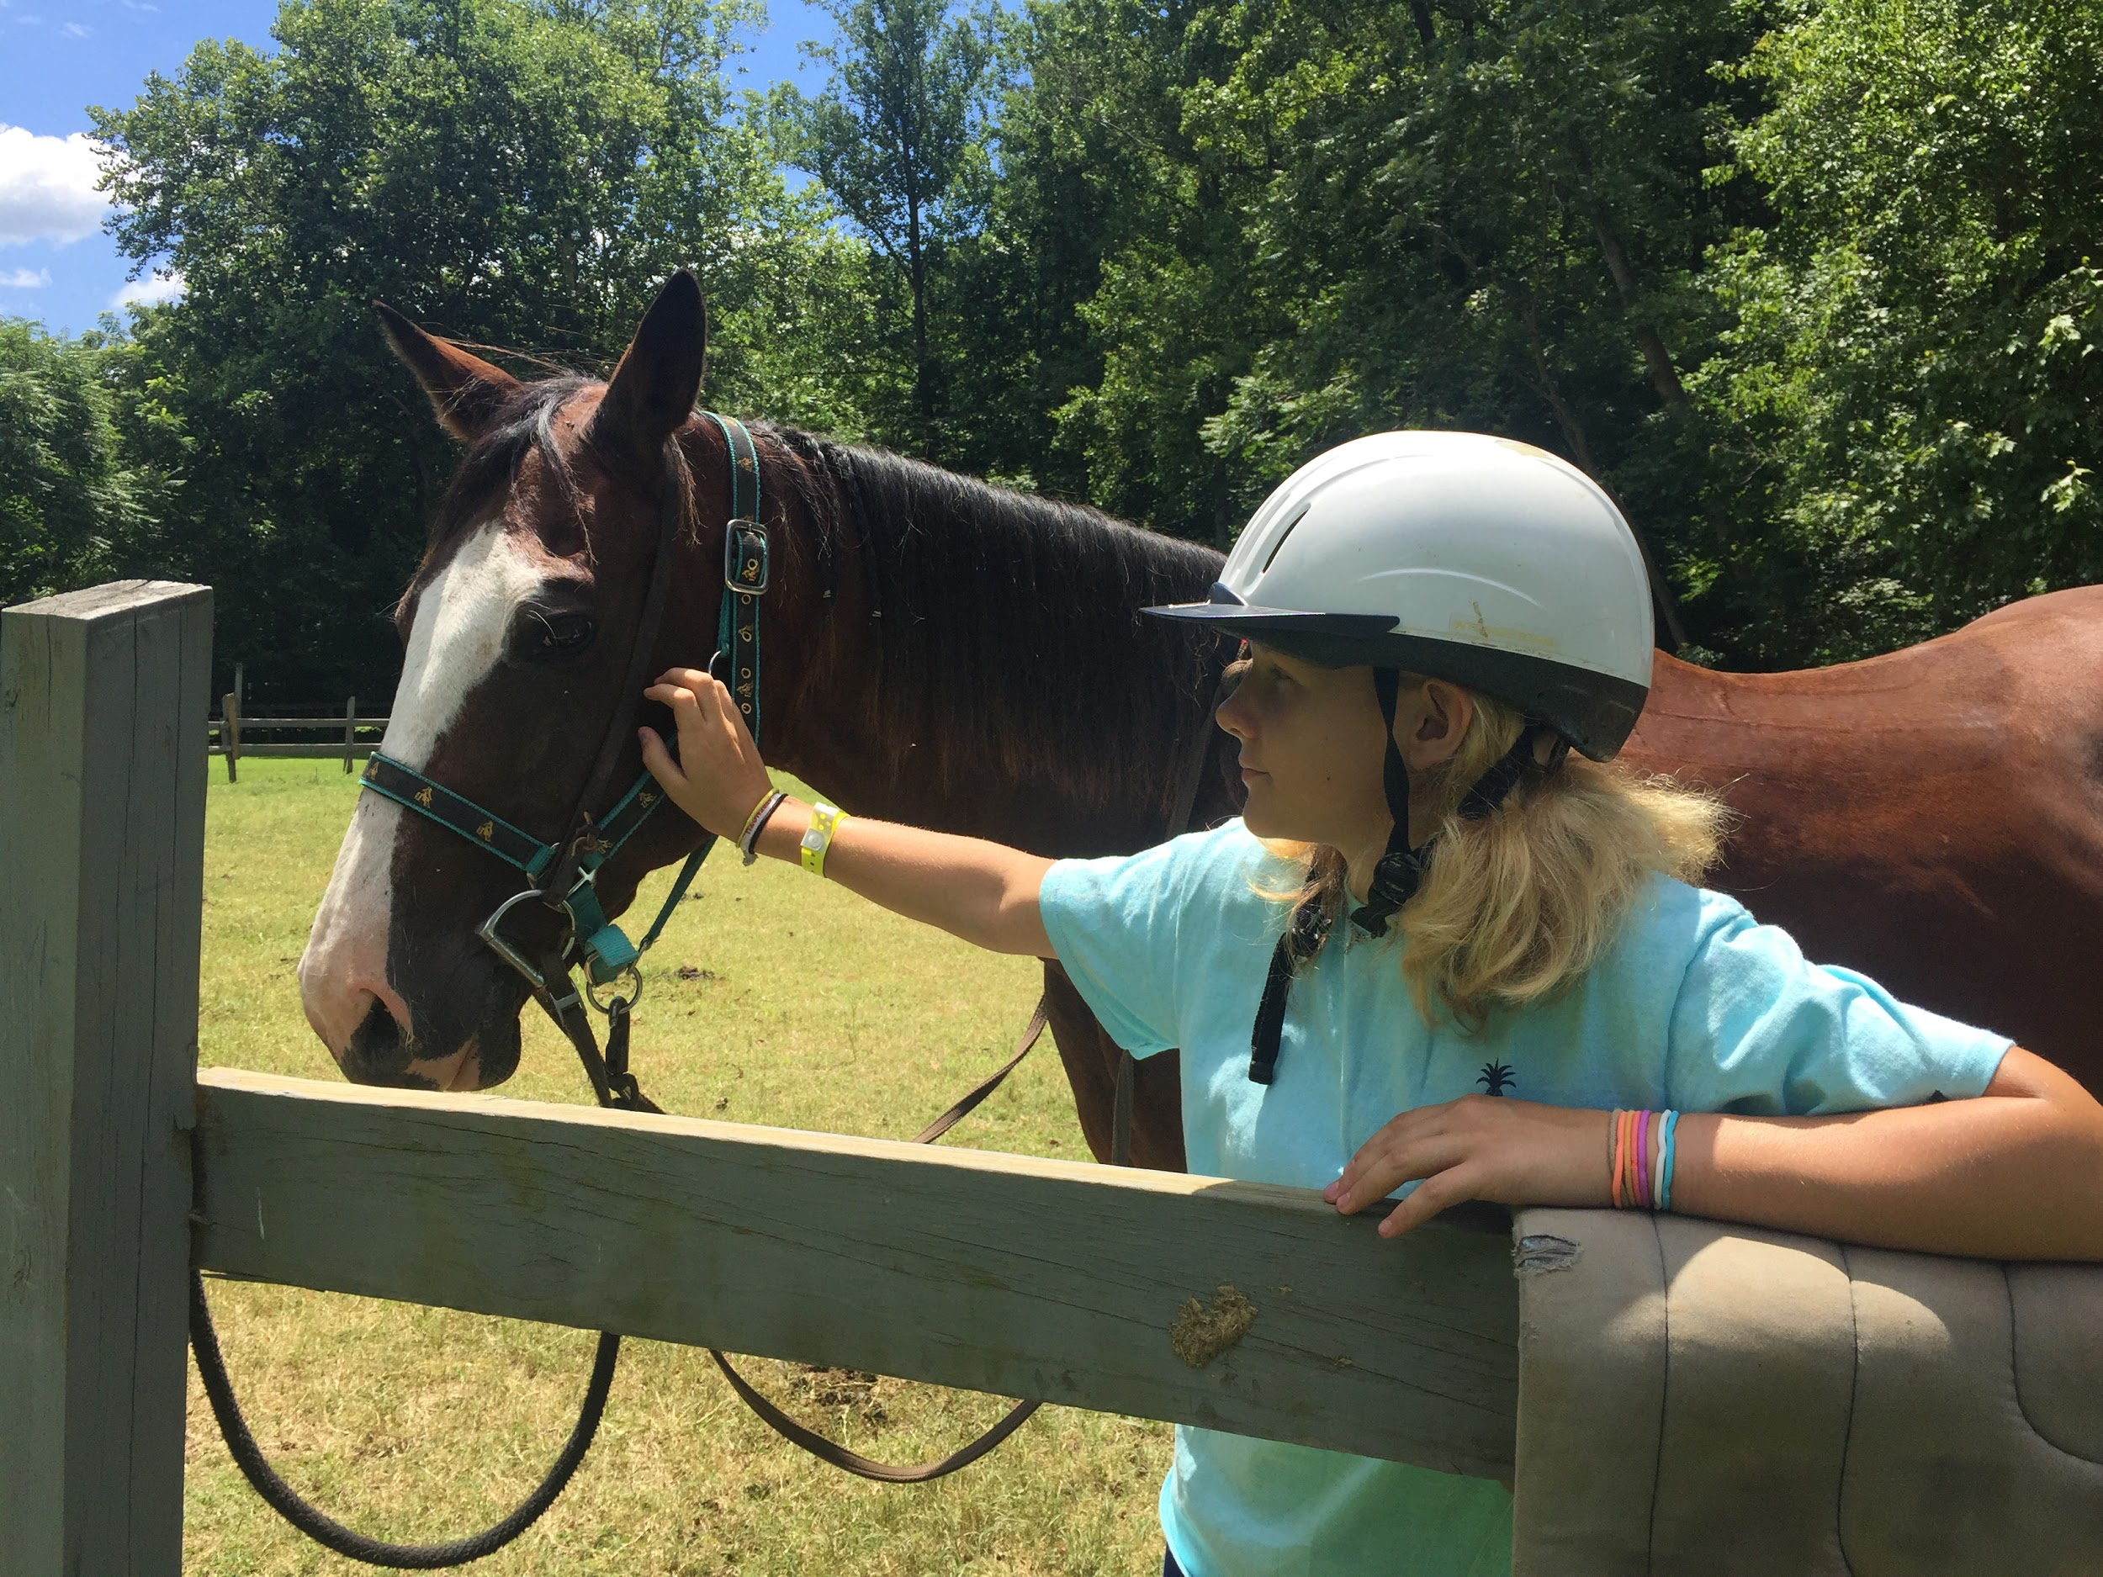
My heart to greater loyalty...
What are the social implications?
Notes:
Ask participants why these guidelines are important.

Slide 6
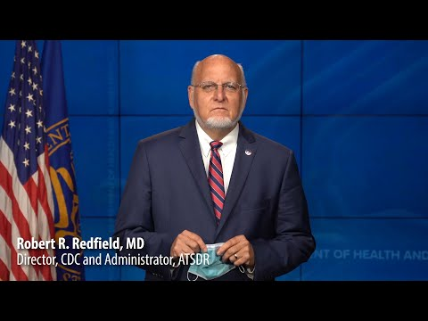
Notes:
Emphasize that, while most youth may not suffer the worst effects of COVID-19, PPE and social distancing help protect vulnerable people (e.g., the elderly, those with underlying health concerns) in the community as a whole. Furthermore, youth are not immune to COVID-19, and the long-term effects of COVID-19 are not well understood.

Slide 7
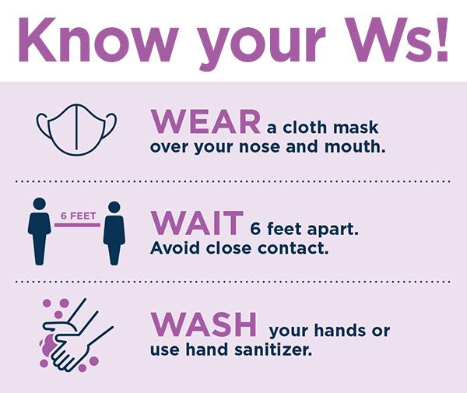
Wear. Wait. Wash.
The 3Ws represent best practices to control the spread of disease when a treatment and vaccine are still in development.
Image from NCDHHS
Notes:
This is the North Carolina DHHS language that youth may recognize.

Slide 8
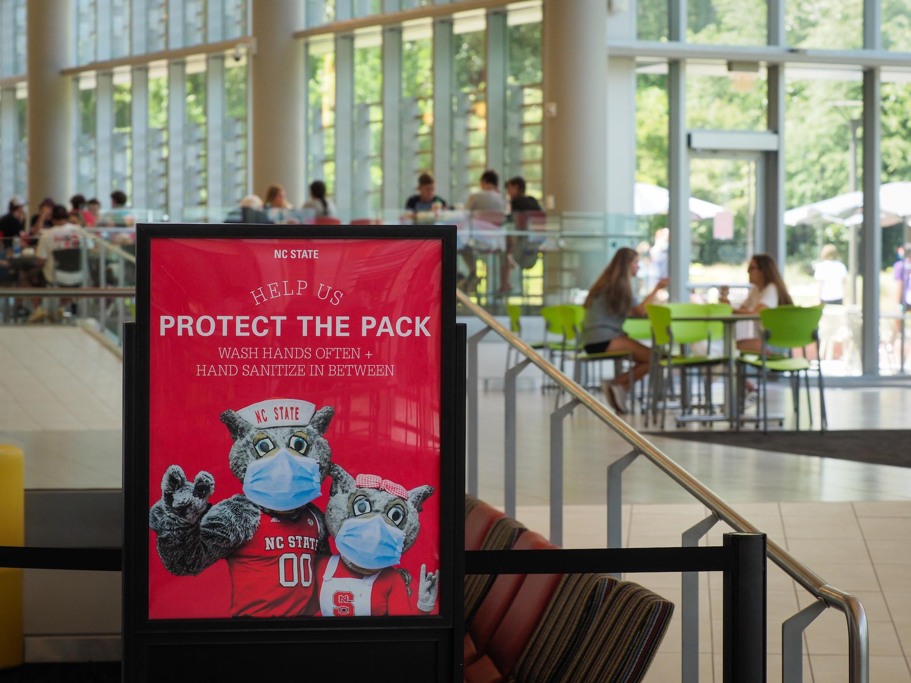
Community Standards: Protect the Pack
RUL 04.21.01 (Personal Safety Requirements Related to COVID-19).
Wear a face covering.
Practice good hand hygiene.
Maintain an appropriate physical distance from others.
When sick, stay home.
Follow all directions given by university officials and public health authorities,
Follow mass gathering limitations.
Comply with all local and state laws and ordinances.
Photo courtesy of NCSU
Notes:
Reminder that there are multiple guidelines that influence local programming.
Point out that “Protect the Pack” emphasizes that the personal safety requirements are connected to the community as a whole.

Slide 9
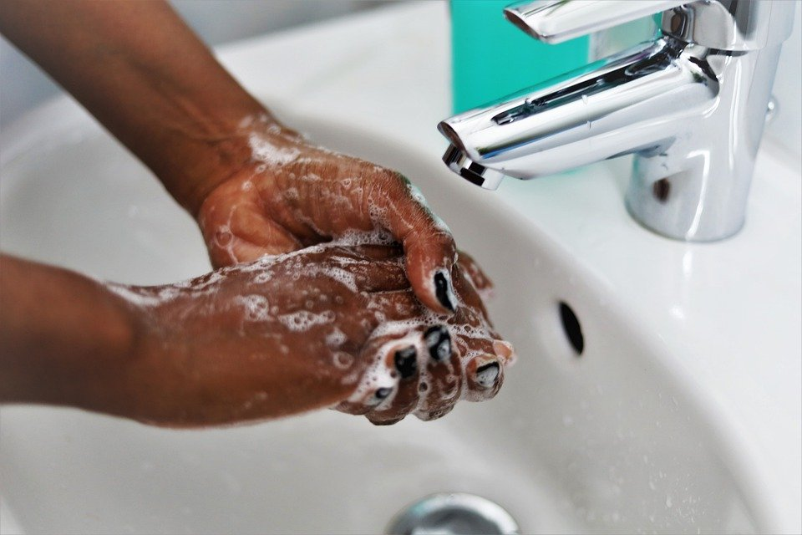
My hands to larger service...
What will we need to do?
Image by Jeyaratnam Caniceus from Pixabay

Slide 10
Before the Meeting
Get approval from the CED.
Make a plan.
Find a location.
Communicate with stakeholders.
Collect registrations.

Slide 11
Make a plan.
Coordinate with your local health department:
Sanitation procedures
Registration and sign-in procedures
Signage
Procedures to support youth with social distancing
Local procedures (e.g., reporting, deep cleaning, etc.) to follow in the event that a positive COVID-19 case is reported.
Notes:
Þ Contact your local health department to assure you are abiding by all local regulations. This will be important should recommendations change and/or a meeting/event participant later tests positive for COVID-19.
Even if CEDs have already created a plan, it is still a good idea to coordinate with the local health department prior to face to face programming. This helps to get everyone on the same page within a given community and establishes a partnership before a problem arises. The local health department will also be the most up-to-date resource for current federal, state, and local guidelines related to COVID-19.
Þ Create and prepare any signs or documents that will be used at the event, communicating procedures like: check-in, drop-off and pick-up procedures, etc.
Þ Establish a protocol for the use of activity supplies/equipment. How will they be used and effectively disinfected during the activity?
Þ Be certain that all youth attendees have appropriately registered for the activity prior to their arrival.
Þ Consider any special accommodations attendees have made known.
Þ Youth should bring their own snacks and drinks.
This is also consistent with how NC public schools are operating: https://www.newsobserver.com/news/local/education/article244887787.html

Slide 12
Find a location.
Meetings should be held in public spaces
At this time, North Carolina 4-H will not offer face-to-face programming in personal residences because of potential liability according to the Tort Claims Act. Considerations include:
cleaning (sanitizing versus disinfecting and the need to hold a space before cleaning),
physical distance requirements,
potentially infected individuals in a private residence for a NC State event (asymptomatic transmission).
Prefer locations designed for spacing, industrial sanitation practices of surfaces/biological use areas such as community facilities, schools, churches, businesses.
Notes:
Find the most recent occupancy guidelines here: https://covid19.ncdhhs.gov/guidance#phase-3-easing-of-restrictions
Considerations for meeting spaces:
Þ Ensure that the size of the room or facility is large enough to allow for the number of expected attendees and in accordance with current local, county and state guidelines (whichever is the most stringent).
Þ Space tables, chairs, shooting lines, far enough apart to ensure social distancing (>= 6-feet apart).
Þ Place markers on the floor to indicate 6-foot spacing.
Þ Ensure adequate ventilation or air handling equipment is available for indoor spaces.
Þ Consider encouraging attendees to bring their own seating (camp chairs) as applicable.
Per communication from NC State Emergency Management and Mission Continuity within the Department of Environmental Health and Public Safety,
Volunteers should be made aware that they may not be covered under the North Carolina Tort Claims Act if someone contracts COVID-19 during a 4-H meeting held in a private residence.

Slide 13
Communicate With Stakeholders.
No less than 24 hours prior to the meeting, let families, volunteers, guests, and anyone else participating know
Safety protocols for the meeting
Social distancing requirements
Appropriate PPE
Arrival/dismissal
Procedures for materials
Accommodations for religious or other needs
Reasons to stay home
Experiencing COVID-19 symptoms
Contact with a known COVID-19 positive case within the past 14 days
Notes:
Activity health protocol, standards and best practices will be communicated to all attendees prior to their arrival. This may include required/desired PPE, cloth face-masks, gloves, sanitizing solution, etc., dependent upon the nature of the planned activity.
No less than 24 hours prior to the meeting, notify all meeting participants of your opening protocol.
This slide deck should be used to train volunteers. If possible, you may want to hold a virtual pre-meeting for families and guests prior to the first face to face meeting to explain new procedures (for working with youth, see https://docs.google.com/presentation/d/1sCYtCNvjBBKznhexxMLDPYuZrMi2laYwaGpwkGAVg1U/edit?usp=sharing)
In the event that a participant requests a mask exemption, follow the facemask exemption guidelines released for livestock shows:
“NC State University has defined the processes to seek an accommodation to this guidance due to a disability as defined under the Americans with Disabilities Act (ADA) or for religious beliefs.
In order to request an accommodation to the facemask guidance, you must:
1. Fully complete and submit a Request for Religious Accommodation form; or
2. Contact the NC State ADA Coordinator at ada_coordinator@ncsu.edu or call 919-515-3148 for ADA accommodations.
*A request can be served more effectively if the request is provided at least 10 business days prior to the date of the event for which you are requesting an accommodation. Exemption requests cannot be considered by Show Management on the day of the show.”
Inform all possible attendees that they should stay home if they:
o are experiencing any symptoms of COVID-19.
o have had known contact with anyone having COVID-19 in the last 14 days.
o are considered at high risk themselves
o live or work with individuals that are at high risk
§ those 65 or older
§ those who are immunocompromised
§ those who have complicating health factors as identified by the CDC
o answer “Yes” to any of the following questions:
§ Do you currently have a fever or chills?
§ Do you currently have a worsening cough, not caused by another condition?
§ Do you have a sore throat?
§ Do you have difficulty breathing that is not normally have?
§ Do you have worsening muscle aches that you do not normally have?
§ Do you have worsening headache that you do not normally have?
§ Do you have a new loss of your sense of taste or smell?
Note: If participants answer yes to any of these questions or show any signs of COVID-19, politely ask them not to participate in the activity and encourage their parent/guardian to contact a healthcare provider.

Slide 14
Collect Registrations.
Monitor the number of participants:
Social distancing maximums include EVERYONE at the meeting: agents, volunteers, guest speakers, youth, etc.
The number of participants cannot exceed room space requirements to allow for proper social distancing.
Ensure that all forms, including liability waivers for COVID-19, have been completed.
Notes:
Ensure that the number of attendees complies with local, county, and state health guidelines. This number includes everyone, 4-H agents, volunteer leaders, youth, and others participating in the activity. This number cannot exceed room space requirements that allow for proper social distancing.
Consider providing a copy of the NCDHHS COVID-19 health questionnaire to all participants prior to the first face to face meeting and posting it in the meeting space. https://covid19.ncdhhs.gov/about-covid-19/symptoms
Pre-registering participants will allow you time to make sure that each participant has a completed COVID-19 waiver on file.

Slide 15
During the Meeting
Follow your planned check-in/ check-out protocols
Support proper social distancing
Teach and practice good hand hygiene
Model and encourage appropriate use of PPE, including cloth face coverings
Ensure materials are handled safely

Slide 16
Manage Traffic Flows.
Post signage to support social distancing.
Use visual cues to designate areas for different activities
Designate a “sick bay” space to isolate participants who may become ill during the meeting.
Aim for a one-way flow into, out of, and around meeting spaces.
Where possible, separate entrance and exit spaces to safely move people.
If space allows, keep check-in/out away from meeting spaces
Plan no-contact activities for youth to complete during departure times.
Notes:
Þ Have a check-in process in place and follow it. (i.e. Verifying or supplying PPE, taking and recording participants temperature upon entry, hand-washing, directions on where to sit, practicing social distancing, etc.)
Þ Take each participants temperature before they join other participants. Record the temperature on the registration form. Using a forehead thermometer will allow you to record temperatures with minimal time and disinfection required.
Þ Maintain social distancing (6-feet) between participants (by households) throughout the activity.
Þ Have supervised activities ready for youth to do while waiting to be picked up. These could be individualized games, handouts, etc., that do not involve contact with others.
Facilitators may need to modify or remove activities that would result in youth spending time in close proximity. Access to the meeting space should be restricted to meeting participants (youth, facilitator/agent, and any invited guests). It is strongly recommended that caregivers, siblings, and other non-participants should not enter the meeting space unless necessary.

Slide 17
Wash Your Hands.
Hand hygiene is essential.
Provide participants with multiple opportunities to wash hands:
Upon arrival/before dismissal
Before/after handling cloth face coverings
Before/after eating
Before/after using any shared materials
Teach effective hand-washing procedures.
Daily Spark
After Dinner Science/Microbiology
Sanitizer (at least 60% alcohol) can be used if handwashing is not available.
Notes:
Þ Have hand sanitizer available at the door for use upon arrival and introduce best practices for proper hand-hygiene: avoid touching their face, mouth, nose and eyes, and they should cover coughs and sneezes.
Þ Prohibit hand-shaking, hugs, and other unnecessary contact.
Shared materials should also be sanitized between users. You may need to consider providing individual sets of high-touch materials (e.g., crayons, pencils, glue) or asking youth to bring their own materials to reduce the risk of spreading COVID-19.
Youth should also be reminded to refrain from touching their face or cloth face covering. They should wash hands if they need to replace their cloth face coverings for any reason.
Hand sanitizer alone is far less effective than hand washing, but should be used whenever hand washing facilities are not available.

Slide 18
Channel Your Inner Superhero.
Mask Up.
Cloth face coverings are required in public in North Carolina for most people aged 5 or older if it is not possible to maintain 6 feet of social distancing.
As of July 1, 2020, and at least through the fall 2020 semester, students, faculty, staff, and visitors are required to wear face coverings in all university programs (extended to off-campus programs).
Extra masks may be picked up from the University.
Additional PPE, such as gloves, may be needed depending on the activity.
Notes:
All of the Governor’s Executive Orders relating to COVID-19 are available at https://www.nc.gov/covid-19/covid-19-orders.
Executive Order 147 establishing the mask mandate: https://files.nc.gov/governor/documents/files/EO147-Phase-2-Extension.pdf
Cloth Face Coverings FAQs: https://files.nc.gov/covid/documents/about/managing-overall-health/FAQs-Cloth-Face-Coverings.pdf
Executive Order 169 establishing a move into Phase 3: https://files.nc.gov/governor/documents/files/EO169-Phase-3.pdf
Phase 3 FAQs: https://www.nc.gov/covid-19/staying-ahead-curve/phase-3-faqs
Volunteers, agents, and other participants should be aware that plastic shields do not fit close to the face and therefore present a greater risk of COVID-19 spread.
In the event that a participant requests an exemption to this policy, follow the facemask exemption guidelines released for livestock shows:
“NC State University has defined the processes to seek an accommodation to this guidance due to a disability as defined under the Americans with Disabilities Act (ADA) or for religious beliefs.
In order to request an accommodation to the facemask guidance, you must:
1. Fully complete and submit a Request for Religious Accommodation form; or
2. Contact the NC State ADA Coordinator at ada_coordinator@ncsu.edu or call 919-515-3148 for ADA accommodations.
*A request can be served more effectively if the request is provided at least 10 business days prior to the date of the event for which you are requesting an accommodation. Exemption requests cannot be considered by Show Management on the day of the show.”

Slide 19
Your First Meeting: How to Help Youth
Teach the Routines
Let Youth Process Why
Register for each meeting before it happens.
Sign in when you arrive.
Follow all posted signs.
Wash your hands.
Wear a mask.
Stay at least 6 feet away from others.
Stay home if you do not feel well OR if someone in your household is not feeling well.
Keep away from crowds.
Match the life skills to the new routines.
There may be more than one life skill for any given routine.
There is not a right or wrong answer for this task.
Be ready to explain your thinking.
Notes:
Ensure that all youth have received the routines and expectations in advance of the return to face to face meetings. This is part of the pre-meeting communication.
The Youth Toolkit is available to train youth as part of the first face-to-face meeting.
A template with life skills “sticky notes” that can be used virtually is here: https://docs.google.com/presentation/d/16wTas18VZbhcxK0j6cS5BENhXddgemdnCWpeQSZlO7k/edit?usp=sharing
Make a copy of the slide(s) you want to use and share with in breakout rooms. Participants can manipulate the life skills as needed.

Slide 20
If Someone Feels Ill DURING the Meeting
If a participant exhibits COVID-19 symptoms:
Quarantine the participant away from others.
Contact the guardian to pick up the participant.
Immediately clean and disinfect the area.
Contact the CED.
Notes:
Consider self-monitoring your health for any possible COVID-19 symptoms over the next 14 days. You can assess your own symptoms at https://covid19.ncdhhs.gov/about-covid-19/symptoms. Information is available in English and Spanish at this site.

Slide 21
After the Meeting
Disinfect all surfaces according to the CDC guidelines before using the space again.
Complete any additional procedures as recommended by your local health department.
You might want to keep a notebook:
Briefly jot down notes about the meeting in case they are needed later on.
Notes:
Þ Clean and disinfect all common surfaces as recommended by the Centers for Disease Control (CDC). Following a meeting, the CDC recommends waiting 24-hours before you clean or disinfect the facility, but follows with…If 24-hours is not feasible, wait as long as possible (this time allows the virus to settle before cleaning). Common surfaces include tables, counters, doorknobs, light switches, countertops, handles, phones, keyboards, toilets, faucets, chairs, etc.
Þ Be prepared to provide the meeting registration list to the health department, upon request.

Slide 22
If Someone Tests Positive AFTER the Meeting
If a guardian or the health department notifies you of a positive case of a program participant:
STOP programming until CDC guidelines have been met.
Inform your CED and State 4-H Leader.
Provide the program roster to the local health department if requested.
Refer any outside inquiries to the local health department.
Follow appropriate cleaning guidelines.
Notes:
The local health department will take the lead on contact tracing.
HIPPA: Do not release names or personal identifying information of any COVID-19 positive, suspected positive, or otherwise potentially ill individuals to participants or other third parties (e.g., media).
Þ Inform your CED and State 4-H Program Leader that an active COVID-19 case has been identified.
Þ Individuals/clubs/groups must stop face-to face programming until the recommendations for closure/quarantine have been met according to CDC guidelines: CDC Coronavirus.
Þ If asked, provide the program roster to the local health department so contact tracing may proceed. The program roster should include full name, mailing address, and a phone contact.
Þ Meeting/event attendees will be notified by the health department. In line with HIPPA regulations, only the health department should provide information to meeting attendees and the general public.
Þ When a person returns to a group is based on public health/medical advice. CDC gives general guidance: https://www.cdc.gov/coronavirus/2019-ncov/if-you-are-sick/end-home-isolation.html

Slide 23
Cleaning Guidelines If Someone Tests Positive AFTER the Meeting
If you are notified within 7 days of the meeting:
Contact the health department for guidance on cleaning the facility.
If the Cooperative Extension was notified 7 days or more after the infected individual visited the facility, continue routine cleaning and disinfection for a healthy building environment.
Notes:
A person is most infectious 48 hours prior to a positive COVID-19 diagnosis.
https://www.cdc.gov/coronavirus/2019-ncov/community/disinfecting-building-facility.html

Slide 24
Returning to 4-H Following Exposure
When participants may return to face to face programming following an exposure:
Clubs/groups must stop face-to face programming until the recommendations for closure have been met according to CDC guidelines.
Participants should not participate in any additional 4-H face to face programming. Instead, follow public health and medical guidelines including the CDC guidelines for isolation procedures.
Notes:
When a potentially COVID-19-positive person returns to a group is based on public health/medical advice. CDC gives general guidance: https://www.cdc.gov/coronavirus/2019-ncov/if-you-are-sick/end-home-isolation.html
Coordinate with your local health department for the most up to date guidance regarding a return to face to face programming in your county.

Slide 25
October 2, 2020, 5pm:
Phase 3 begins in NC. Localities may have more strict guidelines!
Notify all participants of protocols at least 24 hours prior to the meeting.
Consider a virtual pre-meeting if possible.
Reflect and prepare for the next meeting.
Get approval from your CED.
Follow planned protocols during the meeting.
Train all volunteer leaders.
Clean and disinfect the space per CDC guidelines.
Collect registrations and check forms.
Coordinate with the local health department.
If needed, follow any additional directives from the local health department (e.g., sharing rosters, quarantining, cleaning, etc.)
Prepare the space.
Notes:
Þ Prior to reopening face-to-face programming, agents must train all volunteer leaders, using the Returning to Face-to-Face Programming for North Carolina 4-H – Training for Agents and Volunteers power point presentation. Each volunteer should sign the registration form indicating they have completed this training.
Þ When Governor Cooper declares the beginning of Phase 3 of the North Carolina Reopening Plan, North Carolina 4-H may begin face-to-face programming in compliance with 4-H, state and local regulations. Extension personnel who do not feel comfortable returning to face-to-face programming, should discuss their concerns with their County Extension Director.

Slide 26
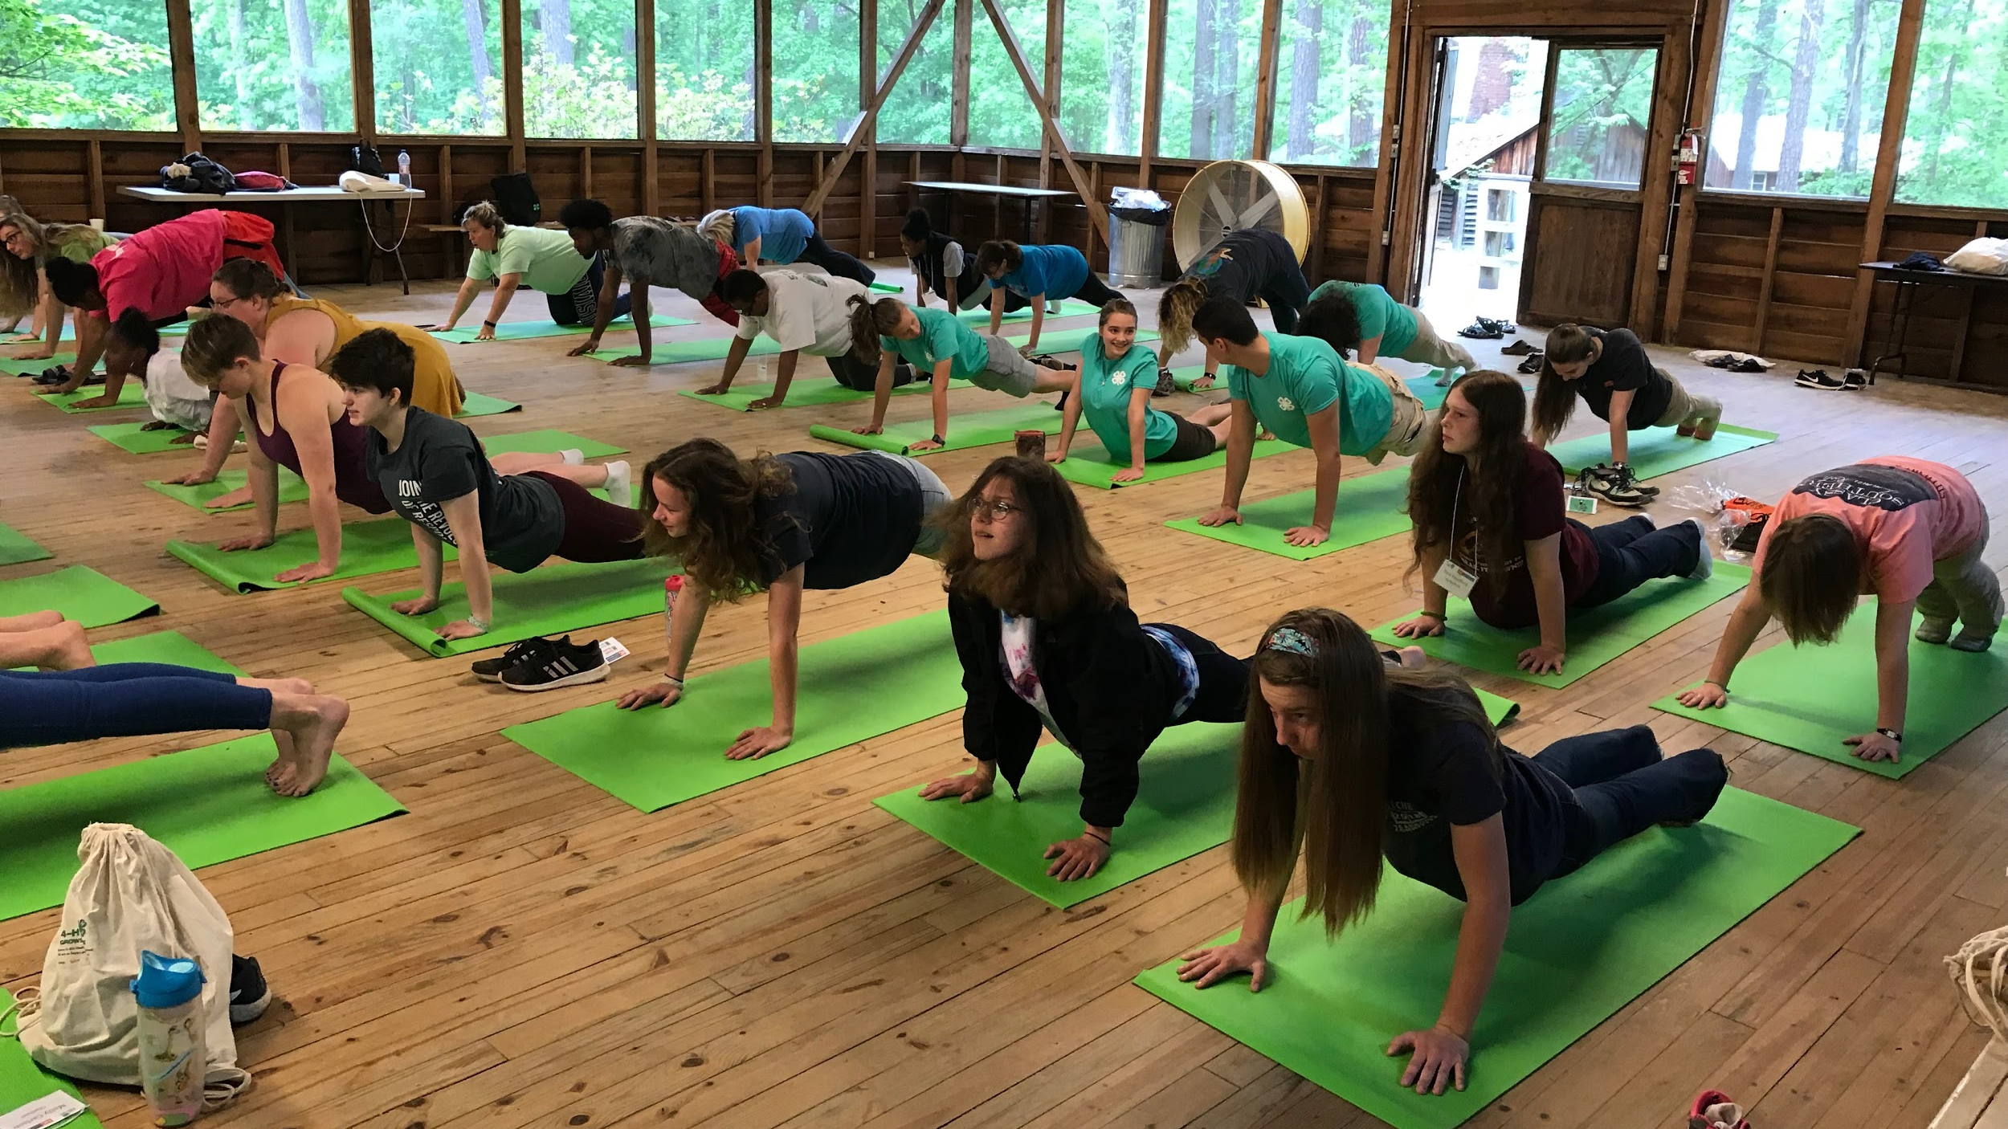
And my health to better living
Notes:
Ask participants to summarize how these guidelines promote health to better living.

Slide 27
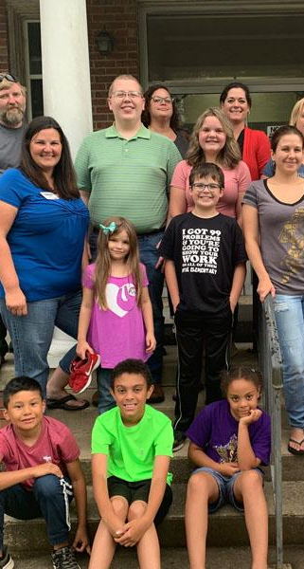
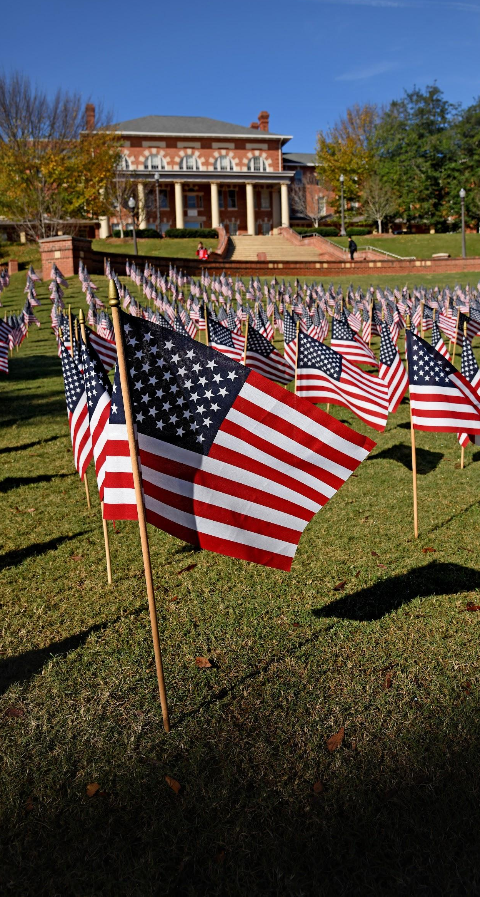
Image by Ioannis Ioannidis from Pixabay
for my club,
my community,
my country, and
my world.
Notes:
Any questions?

Slide 28
Extension staff only:
Please click this link to verify that you have completed this training presentation:
https://forms.gle/Mi2s4AXJ3gnedSgZ7

